Slide 1

Chapter 2
Disease and Life Expectancy

Slide 2
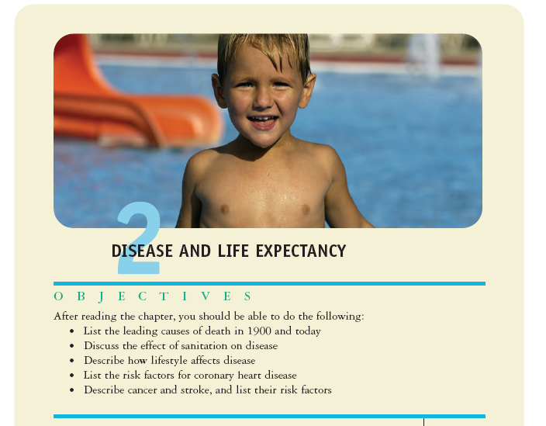

Slide 3
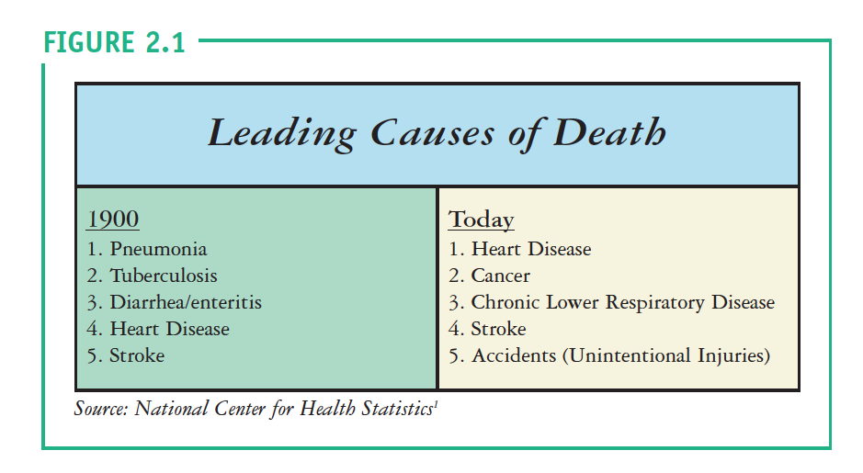

Slide 4
The life expectancy in 1900 was 47 years. The leading causes of death were communicable diseases, caused from infectious agents. The reasons for this are as follows:
Poor sanitation—emptying chamber pots on the streets and manure from animals
Lack of refrigeration and food storage, leading to more spoiled foods—and causing food poisoning
Proliferation of pathogens because of poor sanitation and lack of clean drinking water
Lack of proper medical care—for example, 1 in 5 women died during childbirth

Slide 5
Life expectancy has increased tremendously in the past 100 years. Today, one can expect to live to be in the upper 70s.
That said, the life expectancy could be even higher if it were not for unhealthy living. Today, the leading causes of death—heart disease, cancer, and stroke—are hypokinetic diseases. They are lifestyle related and largely preventable.

Slide 6
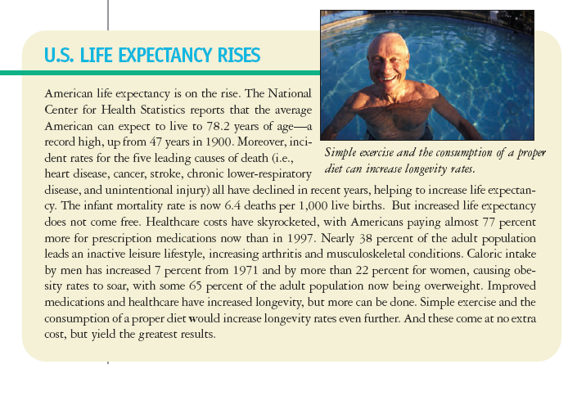

Slide 7


Slide 8
CARDIOVASCULAR DISEASE—an encompassing term used to describe various diseases of the heart and its circulatory system
  Leading cause of death in the US today
  Responsible for some hundreds of billions in direct and indirect costs annually
  The World Health Organization states over 17 million worldwide deaths are attributed to CVD each year

Slide 9
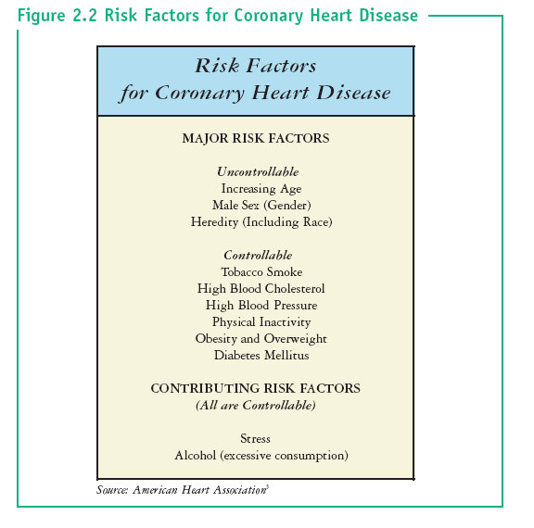

Slide 10


Slide 11
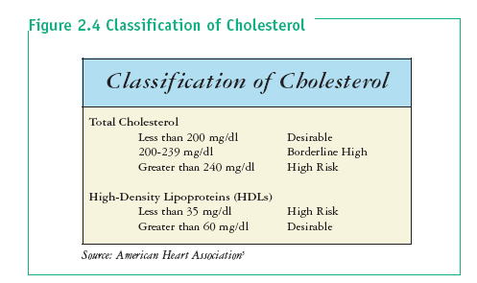

Slide 12
STROKE—when blood flow to the brain is slowed or stopped, also known as a “brain attack.”
  The third leading cause of death in the US today
  Some 700,000 Americans each year suffer from a stroke; that is one every 40 seconds
  80 percent of strokes are preventable

Slide 13
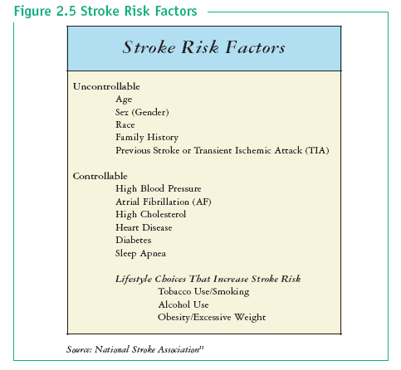

Slide 14


Slide 15
THE NATIONAL STROKE ASSOCIATION LISTS THE FOLLOWING AS ITS STROKE PREVENTION GUIDELINES:
  1. Know your blood pressure. Have it checked at least annually. If it is elevated, work with your doctor to keep it under control.
  2. Find out if you have atrial fibrillation.
  3. If you smoke, stop.
  4. If you drink alcohol, do so in moderation.
  5. Find out if you have high cholesterol.
  6. If you are diabetic, follow your doctor’s recommendations carefully to control your diabetes.
  7. Include exercise in the activities you enjoy in your daily routine.
  8. Enjoy a lower-sodium, lower-fat diet.
  9. Ask your doctor if you have circulation problems that increase your risk for stroke.
  10. If you experience any stroke symptoms, seek immediate attention.

Slide 16
CANCER—when a group of diseases characterized by uncontrolled growth and spread of abnormal cells.
  The second leading cause of death in the United States
  More than 560,000 deaths each year
  Cancer is estimated to cost Americans more than $200 billion annually
  Normal cells are changed by a carcinogen—a catalyst for the development of cancer—and begin to divide, forming a tumor, being either benign or malignant.
  Benign tumors typically pose no major health concerns because they are enclosed in a membrane and do not invade neighboring tissue.
  Malignant tumors area different story. They are cancerous, typically grow rapidly, and spread throughout the surrounding tissue and to others areas of the body.

Slide 17
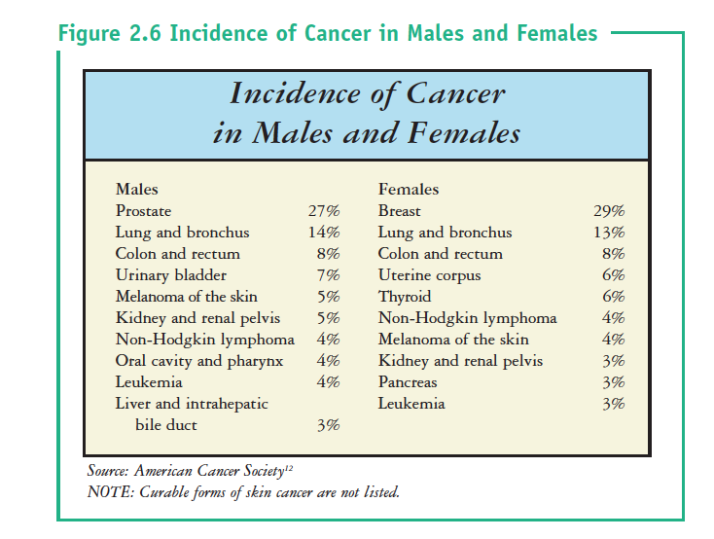

Slide 18
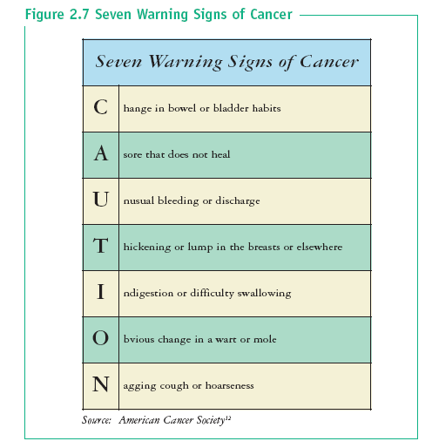

Slide 19
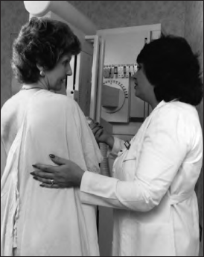
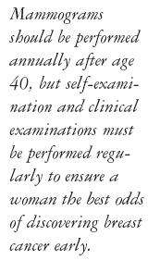

Slide 20


Excessive Sun exposure can increase the likelihood of developing skin cancer, especially for light-skinned individuals. However, modest Sun exposure is necessary for proper vitamin D development, but caution must be used so that the skin does not burn.
  .

Slide 21


Slide 22
